Slide 1


CS 327E: Elements of Databases Final Project
Elias Ansari (eaa957)
Khalid Hamza (kfh294)
Group: Recurscursive

Slide 2
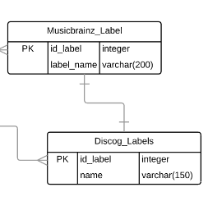
Biggest Challenges
Environmental Setup
Working from different locations and whitelisting IP addresses
Database Design
Validating normalized schema
QuickSight Visualizations
Updating queries
Data Load
Loading metadata from Millionsongs
Ensuring varchar lengths

Slide 3
Data Load – varchar lengths
Problem
User Defined Function (UDF) Python scripts are inherently much slower than an SQL script
The script took over an hour with a gigabit wired connection for a table with 17 million rows (the table ‘Recording’ from Musicbrainz has 48 million rows)
Solution
Implemented a Binary Search strategy which helped find the appropriate varchar length
4000 → 2000 → 1000 → 1500 → 1750 → 1875 → 1937 → 1906 → 1890 → 1898 → 1902 → 1904 → 1905 (failed)

